Slide 1

Buying Motives
Good Salespersons understand what motivates buying
Customers have two motives for making purchases
Rational motives
Emotional motives

Slide 2

Customer Buying Motives
A rational motive X is a conscious, logical reason for a purchase – well thought out What are some rational motives?
Product dependability
Time or monetary savings
Health or safety considerations
Service
Quality
Convenience

Slide 3

Customer Buying Motives
Emotional motives X feelings a customer experiences in connection with a product What are some emotional motives:
Social approval – cool & impress others8
Recognition
Power
Prestige
Many buying decisions involve a combination of both kinds of motives

Slide 4
When Do you need Help to Buy a Product?
Complicated products
Products that need to be demonstrated
Products that are highly technical
Products that are Expensive/high risk

Slide 5
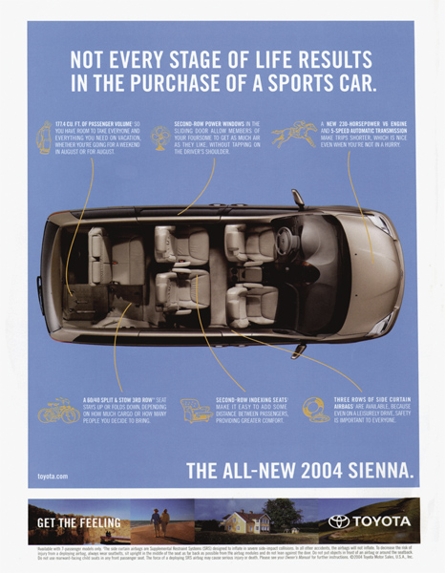
Customer Buying Decisions
A customer makes a purchasing decision based on a variety of factors, including the following:
Previous experience
Time available to purchase
Information required
Frequency of the purchase
Importance of the purchase
Perceived risk of the purchase

Slide 6
Customer Decision Making
Some customers don’t need help from salespeople while others do
This difference is three types of decision making:
Extensive
Limited
Routine
Marketing Essentials Chapter 12, Section 12.1

Slide 7

Extensive decision making X used when little or no previous experience with an item
This category includes those goods and services that:
Have a high degree of perceived risk
Are very expensive
Have high value to the customer
(i.e. home)
High risk involved and a lot of information is needed before buying

Slide 8
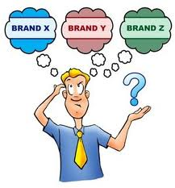
Limited decision making X used when a person buys goods and services that he/she has purchased before but not regularly
What are some examples?
A second car
Certain types of clothing
Furniture
Household appliances
Moderate risk involved and some information is needed before buying

Slide 9

Routine decision making X used when a person needs little information about a product
The perceived risk low because item is:
Inexpensive
Bought frequently
Highly satisfying
i.e. groceries, brand of hair products
Marketing Essentials Chapter 12, Section 12.1

Slide 10

Assignment:
Go to Google Classroom and complete “Review Buying Motives and Decisions”

